Slide 1
This webinar will begin soon
For audio via telephone
United States: +1 (914) 614-3221
Access Code: 524-116-555 Audio PIN: Shown after joining the webinar

Slide 2
COVID-19 Housing Provider Sharing & Problem Solving Session
May 21st , 2020
2:30 pm -3:30 pm

Slide 3
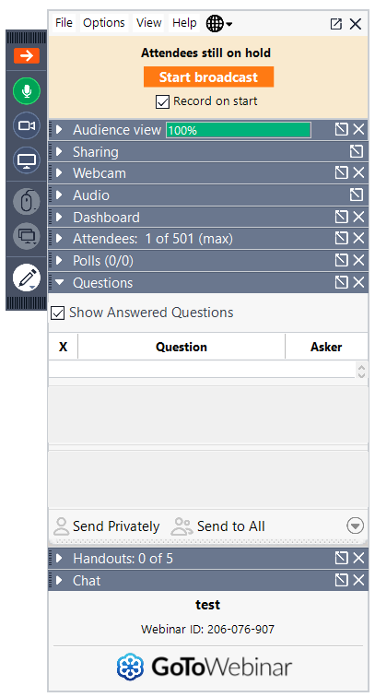
Webinar Housekeeping
Muted until discussion points
Use *6 is you are on a PHONE to mute and unmute yourself
Audio Troubleshooting
If you are having difficulty hearing us, please join the webinar via phone
Click on “Audio” and then click “Telephone”. Please follow dial in instructions
If you are on the phone, please do not put us on HOLD.
Questions
In the Questions/Chat Box

Slide 4
Questions/Chat
Raise Your Hand
if you have a question
All lines are muted
Use the Question Box
to submit questions, ideas, comments, resources, etc.

Slide 5
Goals
Dedicated time for housing providers​
Sharing questions, strategies​, resources
Working toward solutions​ and common understanding

Slide 6
Poll Results: COVID-19 Housing Provider Sharing & Problem Solving Session
Webinar will continue
through June 25th 2020
Yes

Slide 7
Today’s Topics
Wrap-up and Next Topic(s)
Mental Health Awareness and Wellness

Slide 8
Presenters
Sierra Petersen- NAMI(National Alliance on Mental Illness)
Anthony Guerrero Short-NAMI(National Alliance on Mental Illness)
Andrea LeFlore- ReViVe Center

Slide 9
To provide hope and improve the quality of life for those whose lives are affected by mental illness, by providing information and referrals, education, support, advocacy, and active community outreach.
Our Mission
Notes:
The mission of the National Alliance on Mental Illness (NAMI) Chicago is to provide hope and improve the quality of life for those whose lives are affected by mental illness, by providing information and referrals, education, support, advocacy, and active community outreach.
We are the nation’s first and largest grassroots mental health organization.
What NAMI Chicago does:
Facilitate support groups and educational courses
Provide mental health training at schools, workplaces, faith communities, and more
Train first responders on how to respond to mental health crisis
Support those with mental health conditions through in-home recovery support team & moving on program
Policy advocacy
Helpline

Slide 10
6,300 +
Calls completed in 2019
266%
Increase in calls in April 2020
Notes:
Instruct Group: Plug this number into your phone
Through our Helpline, we provide compassionate support and personalized referrals to callers seeking to understand and navigate local mental health services. We have access to over 600 vetted resources.
We are not diagnosing people; we are just noticing. Provide examples.
We are actively maintaining an updated list of services and closures related to COVID-19 – The NAMI Chicago team is available to help with support and resources during this time.
We are now contracted through the city so all 311 mental health calls come to us.
More than ever right now, we need connection. Connection is the glue of our community, and community gives us the strength to push through fear and uncertainty. We should be thinking about reaching out to our loved ones and our support networks right now as much as we think about washing our hands.
When you begin to isolate, if you are overwhelmed, if you start to feel depressed, remember to reach out (OR IF YOU ARE WORRIED ABOUT A CHILD/ FAMILY FOR ANY OF THESE REASONS). For a listening ear, or to talk through anxious feelings or changes in your lifestyle, NAMI Chicago's Helpline is here for you. We're open to take your call from 9a-8p Monday-Friday, and 9a-5p on weekends. We can also help you connect to mental health resources or other supports that you may need (for yourself or someone else).
NAMI Chicago is also offering virtual and phone support groups during this time, for people to connect with others experiencing mental health symptoms.

Slide 11
When to Refer to the Helpline
There is an identifiable mental health service need
An individual seems to be experiencing mental health symptoms
There is an additional resource need (including needs related to the COVID-19 emergency)
Housing/rental assistance, food security, legal services, etc.
Notes:
ALWAYS follow your organization’s outlined protocols and structures FIRST
NAMI Chicago can help with issues that are not addressed by existing protocols, follow up and referrals after school protocols have been followed, and continuing connection for a family that needs additional support. The Helpline exists as a way to keep families and students from falling through the cracks, and can be a particularly useful resource while schools are closed and interaction with students/families is limited.
When to refer:
There is an identifiable mental health service need
Example: “I need to find a therapist/support group/psychiatrist for my child in Chicago.”
An individual seems to be experiencing mental health symptoms
Someone is experiencing depression, anxiety, paranoia, delusions, hallucinations
There is a mental health or resource related need
Housing/rental assistance, food security, legal services, etc.
Examples:
“I’ve been feeling hopeless.” “I feel like such a burden.” “Someone is watching/following me.”
“My child is struggling with their mental health and I don’t know where to get help for them.”
“My child was already struggling with their mental health, and it has gotten worse since we have been isolated.”
“Our family is not sure of where to go for help and we are struggling.”
Frame the conversation around support
“It sounds like you could use additional support. One organization that can be helpful is NAMI Chicago.”
Explain the Helpline
“NAMI Chicago’s Helpline has access to over 650 mental health resources; they will work with you to determine what will best fit your situation and they can follow up with you regularly.”

Slide 12
Verbal Communication Techniques
Active Listening
Normalize
Express your concern
Empathy Statements
“Sounds like a ____ day.”
“That is a lot to deal with.”
“It must be confusing.”
“It sounds like you…”
“Let me see if I understand.”
Notes:
Here are some other tips that can be useful. Also, “How are you today?”
Active Listening
-Encouraging, restating, effective silence, summarizing, “I” statements, empathy
-Pay attention
-Don’t cut people off
Video: Brene Brown on Empathy (Click Icon)

Slide 13
What is Occupational Therapy (OT)?

Slide 14
Engagement as Wellness
Supporting clients as active agents in their lives
Supports
Strengths-based assessments
Individual, group, and peer mentorships
Purposeful engagement
Individualized and strengths-based
Structured time use
Barriers
Income
Lack of resources
Mental illness
Substance use
Community integration
Boredom
Lack of productive time use
Trauma history

Slide 15
Practice Scenario
A client in supportive housing after 5 years of homelessness presents with ongoing mental health and substance use concerns. When you speak with the client, they report feeling “stuck between these 4 walls”, bored 14 hours per day, and “sick of this social distancing”. The client wants to get a job but has been unsuccessful in the past. The client also has a significant trauma history and a diagnosis of PTSD.
The client’s primary occupations (or ways they spend their time) are substance use, watching TV, and accessing social services.
Occupational Questions:
What desired roles does the client identify?
How can the client be supported in participating in meaningful activities?
What could support the client in structuring their day?

Slide 16
Future Topics & Next Session
Notes:
Denise

Slide 17
Future Topics & Next Session
Future Topics
Next Session
COVID-19- Lessons Learned and Training Series Opportunity- Avi Rudnick- Chicago House and Laura Bass- Facing Forward
??? (Put it in the chat)
Email (twinbush@allchicago.org)
Thursday, May 28th
2:30 pm – 3:30 pm
Same Link as This Week?
Would you like to help plan or facilitate a future session?
Contact Torelen (twinbush@allchicago.org)

Slide 18
Questions
Ideas
Feedback

