Slide 1
The webinar will begin shortly
Please stand by
For audio via telephone
Dial-in number: (425) 436-6371
Access Code: 432873#
If line is busy, please wait a few minutes and try again.

Slide 2
Homeless Services Division & Continuum of care COVID-19 Update
Connecting our Partners with Information to Stay Healthy
Presented by All Chicago, DFSS and CDPH
Information Current as of April 10, 2020
Notes:
MAURA
[Welcome and intros]
Megan Cunningham, Managing Deputy Commissioner
Dr. Wilnise Jasmin, Medical Director for Behavioral Health
Nicole Bahena
Jennifer Fabbrini

Slide 3
Housekeeping
Due to the volume of participants, everyone has been placed on mute.
Please submit questions via the chat tool and we will respond to questions after going through the slides.
Please use the chat to notify us of any technical issues.
If you are having difficulty hearing us, please join the webinar via phone:
Dial-in number:
(425) 436-6371
Access code: 432873#
Notes:
MAURA

Slide 4
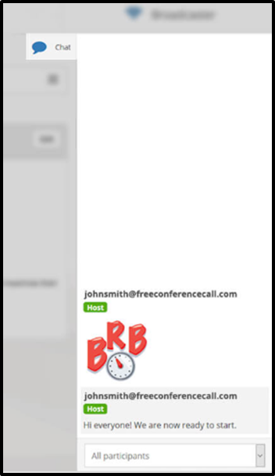
Questions
•All lines are muted
•Use Chat Box to submit questions
Notes:
MAURA

Slide 5
Goal of Combining Webinars
Starting today, this is a co-facilitated weekly COVID-19 Response webinar convened by All Chicago and the Chicago Department of Family and Support Services (DFSS).
The goal of combining the All Chicago and DFSS webinars is to streamline and enhance communication about the Chicago homeless system’s COVID-19 response.
Notes:
NICOLE

Slide 6
Agenda
Provide an update on the City’s COVID-19 response.
Review screening and isolation procedures in shelters.
Share a progress report from CDPH on the Community Mitigation Strategy.
Update on HUD and CoC from All Chicago
Reminder of commitments and discussion of next steps.
Generate questions to help us support real-time needs.
Notes:
MAURA
Thank you again for joining us today. Today our goals are to...

Slide 7
City Response Updates Shelter Decompression
The City has been bringing on shelter beds to support shelters in implementing social distancing.
Three temporary shelter sites are operational, providing roughly 400 beds for single men, youth, and returning citizens. An another site with 200 beds for single women and families is opening as soon as staffing is in place.
To date, over 200 clients have been relocated.
The City's Emergency Operations Center (EOC) is working to bring additional facilities on line, identify staffing and enhanced transportation resources.

Slide 8
City Response Updates Shelter Referral
Residents can request shelter by calling City Services at 311:
Call 311 & make a “Request for Shelter”
Catholic Charities is coordinating transportation to shelter from any location in the city.
Residents can wait for transportation at any Community Service Center during business hours: Monday-Friday 9-5PM.
Help us improve connection to shelter by reporting any issues via the DFSS-Homeless@cityofchicago.org email.
Please include:
When (time and date) the person called
Who the person talked to (if they think it was a 311 operator or a Catholic Charities staff member)
What message they were told
Contact info for the person who made the call (if possible and appropriate)
Notes:
We know that there have been issues, including miscommunication and delays, in shelter referrals through 311 and Catholic Charities. Please report any issues to us through the DFSS Homeless email address.

Slide 9
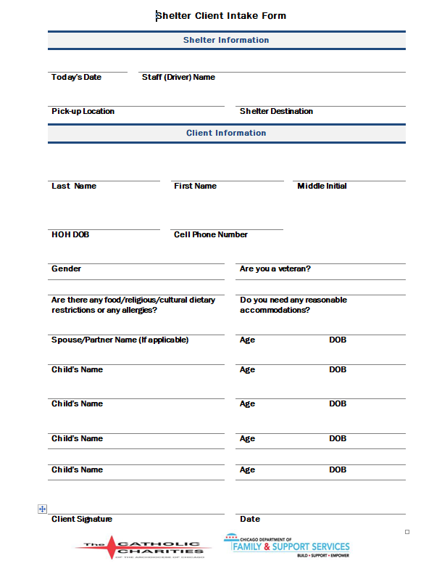
City Response Updates Shelter Referral
The City has contracted for supplemental transportation capacity, so transportation to shelter will be provided by either Catholic Charities or SCR.
Clients who are transported by SCR will have a modified intake form.
Shelters must do intake 24/7, seven days a week, including the weekends.
Notes:
Catholic Charities and SCR are NOT transporting COVID+ individuals. That falls exclusively to EMT/Fire. SCR is supplementing CC in the transport of COVID negative people to shelter.

Slide 10
City Response Updates Shelter Referral
DFSS expects that programs continue operating at social distancing levels for the duration of this crisis. If you do have an opening at your social distancing capacity, please:
Promptly report any bed availability to Catholic Charities (all shelters). Once you have reported your availability to Catholic Charities you do not have to report again unless there is a change and a bed becomes available.
Notify DFSS via the DFSS-Homeless@cityofchicago.org email.

Slide 11
City Response Updates Resources
COVID-19 informational booklets produced by Cook County Health will be available for pick up by shelter and outreach providers today.
Date: TODAY, Friday, April 10, 2020
Pick-up time: 2 p.m. – 5 p.m.
Location: DFSS, 1st Floor Conference Room

Slide 12
City Response Updates Outreach
DFSS Homeless Outreach Program (HOP) team and outreach providers are canvassing the city to:
Share information about COVID-19 along with preventative measures and resources
Identify and monitor vulnerable unsheltered resident
Connect residents to food, water, and sanitation resources. Porta-potties have been set up at the larger encampment sites.
Assess for symptoms using the CDPH screener and triage screening from a Medical Reserve Corps (MRC) volunteer
Assess interest in shelter and refer to temporary facilities

Slide 13
What's coming next
Please keep DFSS informed about any staffing shortages, bed availability, and suspected or confirmed COVID cases via the DFSS-Homeless@cityofchicago.org email.
DFSS, CDPH, and All Chicago will continue to provide frequent updates and will hold weekly joint webinars.

Slide 14
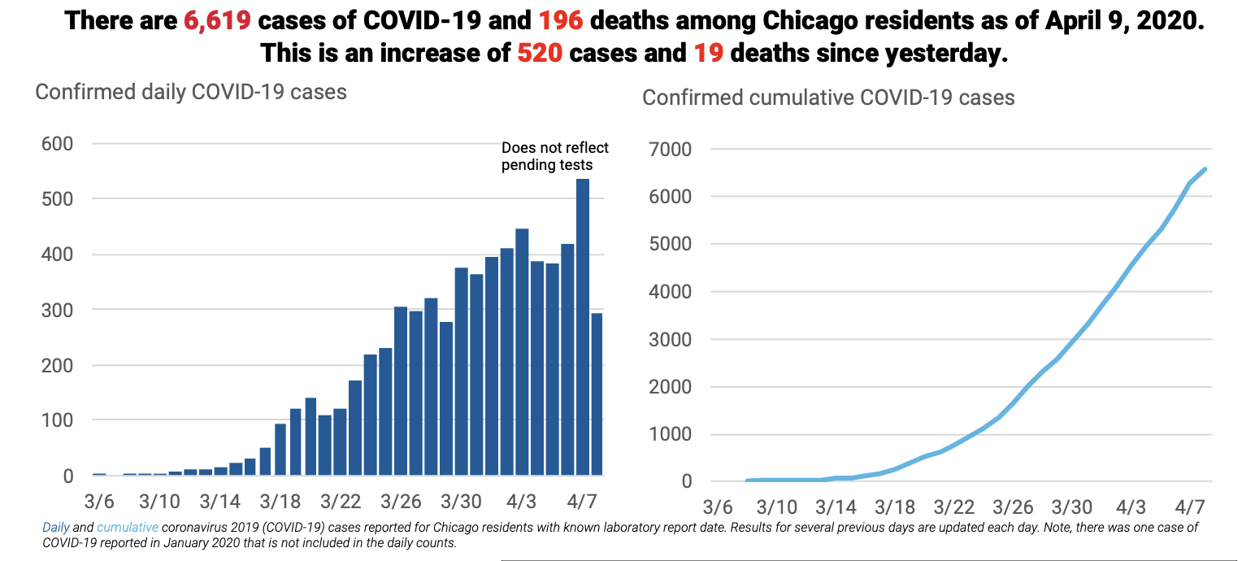
COVID-19 Current Status
UPDATE

Slide 15
Community Mitigation Goal
Develop a city-wide system to prevent transmission of COVID-19 within congregate settings and provide compassionate care for people experiencing homelessness.

Slide 16
Community Mitigation Strategy
PREVENT
IDENTIFY
RESPOND
Take steps to stop or slow the spread of COVID-19 within congregate shelters and encampments
Identify confirmed cases and close contacts through screening / testing and investigations
Provide quarantine and isolation housing options for suspected and confirmed cases

Slide 17
Community Mitigation Strategy
PREVENT
Develop general guidance and screening tools for shelters and outreach workers.
Decompress shelters to promote social distancing and create additional beds.
Provide personal protective equipment (PPE) and thermometers for shelter staff, outreach workers and residents.
Establish supportive housing for people at high risk of hospitalization if they contract COVID-19. (**NEW**)
IDENTIFY
Make clinical screening / testing available for shelters and outreach workers.
Prioritize investigation and providing tailored guidance for congregate settings when cases arise.
RESPOND
Enable shelter and outreach-based referral for quarantine/isolation.
Activate supported isolation facilities for people who are COVID+ with behavioral health needs.

Slide 18
Community Mitigation Strategy : Update
STRATEGY: Activate supported isolation facilities for people who are COVID+ with behavioral health needs. STATUS: In Progress One facility currently operational
Update: 100+ beds coming online at A Safe Haven by Saturday 4/11
Updated discharge/intake protocols will be given to ERs through new HAN Alert; will clarify roles of other Q/I sites
Wraparound services provided by A Safe Haven and Rush University Medical Center
Referrals from hospitals, may consider other sources in the future
Model could be expanded or replicated based on need, actively pursuing other partnerships

Slide 19
Community Mitigation Strategy : Update
STRATEGY: Enable shelter and outreach-based referral for quarantine/isolation.
STATUS: In Progress One facility currently operational, pilot with Lawndale Christian Health Center (LCHC)
STRATEGY: Establish supportive housing for people at high risk of hospitalization if they contract COVID-19.
STATUS: In Progress One facility currently operational, pilot with Lawndale Christian Health Center (LCHC)
200-bed facility now available, operated by LCHC
LCHC and UIC conduct shelter-based screening
People with symptoms are transported to the facility for COVID-19 testing
High-risk individuals (>55, no co-morbidities; >60 w/ co-morbidities) moved out of congregate settings with known outbreaks
People who test positive are referred to A Safe Haven for isolation; low-risk people who test negative can safely return to shelter; high-risk people who test negative can remain in LCHD facility
City working to scale this model across city

Slide 20
Challenges
Staffing shortages in congregate settings
Lack of internal medical staff or clinical linkages
Shortage of providers for wrap around support
Outbreaks reported in multiple congregate settings
COVID-19 exposing pre-existing gaps in social safety net

Slide 21
Working to Engage FQHCs for Additional Support
Two potential areas for collaboration to support your work:
(1) FQHC-Shelter Linkage
CDPH would link FQHCs to shelter(s)
Serve as the shelter’s dedicated POC
Engage and assure shelter staff
Deliver CDPH-approved guidance on infection control, PPE, Q/I, etc.
Consult shelter staff on client screening
(2) Support New Q/I Housing Sites for High-Risk Individuals
Build-off of A Safe Haven and LCHC models
Testing on-site
Transportation from shelter
Medical care and wrap around services
Status: Presented to FQHC leadership Friday, 4/10

Slide 22
COVID-19 Reminder: Social Distancing to Prevent Spread (1 of 2)
Limit visitors to the facility.
Minimize the number of staff members who have face-to-face interactions with clients with respiratory symptoms. Use physical barriers to protect staff who will have interactions with clients with unknown infection status (e.g. check-in staff). For example, install a sneeze guard at the check-in desk or place an additional table between staff and clients to increase the distance between them.
Sleeping Areas: In general sleeping areas (for those who are not experiencing respiratory symptoms), ensure that beds/mats are at least 6 feet apart and request that all clients sleep head-to-toe.
Please review COVID-19 Shelter Guidance

Slide 23
COVID-19 Reminder: Social Distancing to Prevent Spread (2 of 2)
Mealtimes:
Have staff hand supplies or food to clients, rather than clients reaching into common supplies.
If feasible, stagger meals to reduce crowding or stagger the schedule for use of kitchens.
Bathrooms:
If feasible, stagger bathroom schedule to reduce the number of people using the facilities at the same time.
Encourage staff and clients to disinfect bathroom surfaces after use.
If feasible, have one designated bathroom for ill persons.
Common Spaces:
Create a schedule for using common spaces. Increase distance between persons. If possible, keep them a minimum of 6 feet apart from each other.
Please review COVID-19 Shelter Guidance

Slide 24
COVID-19 Reminder: CDPH Medical Reserve Corps volunteers
Can assist shelter staff to assess clients with mild symptoms or underlying conditions through a telehealth assessment
Medical volunteers are on call 8:00am - 8:00pm. To reach:
Dial 312-746-4835, it will initially route through 311.
Ask the 311 operator to connect you to the COVID-19 General Inquiry Line. They will transfer the call to CDPH's phone bank.
Tell the COVID-19 general inquiry line you need to speak to a "Homeless Shelter Medical Liaison." The COVID-19 general inquiry line will then transfer you to an MRC who is on call at that time.
Consult with the MRC volunteer. Reminder, only shelter staff should be using this line, not the clients directly.

Slide 25
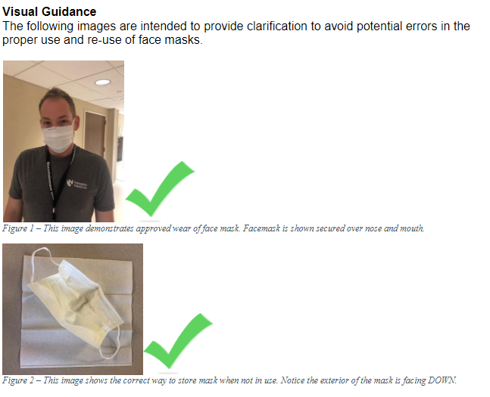
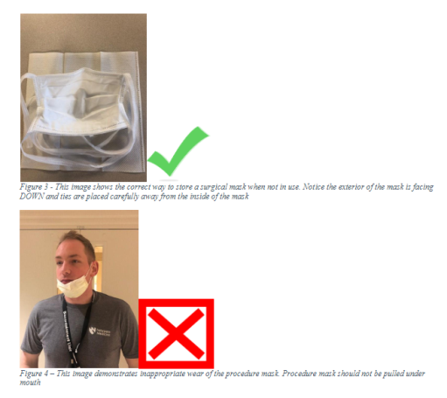
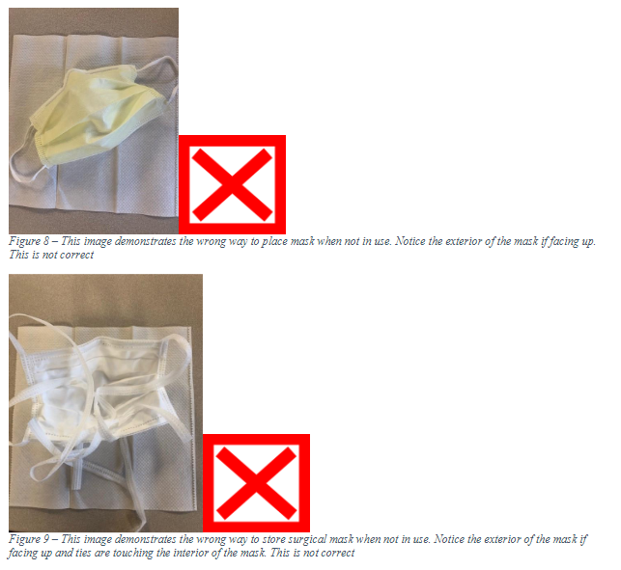
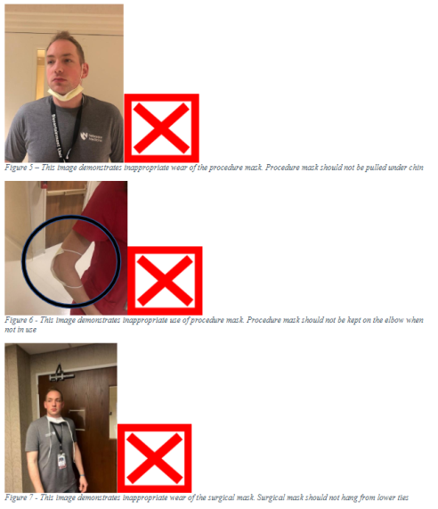
COVID-19 Reminder: Guidance on PPE
New guidance from CDPH on PPE use in congregate settings
Available at: www.chicagohan.org -- April 3, “Facemasks and Important Conservation Practices and Enhanced Environmental Disinfection in Congregate Living Facilities”
Recommendations:
Universal masking for staff
Masking not a substitute for other mitigation efforts, including distancing and hand hygiene
Policies needed on extended use of masks given short supply
Notes:
PAUSE HERE FOR CD

Slide 26
All Chicago’s COVID-19 Response
Promoting Cross-Provider Communication
Maximizing Financial Resources for Agencies Responding to COVID-19
Distilling and Creating Guidance for the Homeless System
Action Agenda Mobilization and Supporting Expedited Placements into Housing (new)
Notes:
Nicole

Slide 27
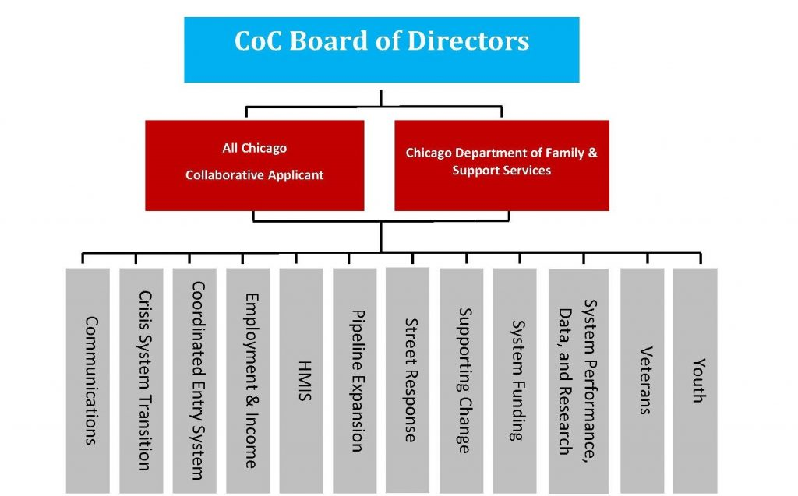
Action Agenda
Notes:
Nicole

Slide 28
COVID-19 Action Agenda Updates
Looking @ Stimulus Funding, Round 1 and Maximizing System Funding for COVID
Establishing long-term need for ending homelessness, and additional needs related to COVID-19
Notes:
Nicole

Slide 29
Supporting Expedited Placements into Housing
Waiver Guidance
CoC Board Policy
Technical Assistance
Coordination
Landlord Engagement
Notes:
Nicole

Slide 30
Weekly Updates
Coordinated by All Chicago
Coordinated Entry - No update today
Advocacy/Federal Stimulus – No update today
Funding opportunities – No update today
HUD, CoC, and housing related updates – Following slides contain updates

Slide 31
HUD Waiver
All Chicago facilitated a Q&A webinar regarding the HUD memorandum about available waivers.
Materials are posted to our Online Learning Portal and to the CoC Slack Channel at bit.ly/ChicagoCoC
Slides & overview
Sample Emergency Recordkeeping Template
Notification Instructions & Template
Sample Notification Letter
CoC-Funded agencies are encouraged to apply as necessary.

Slide 32
HUD Waiver – ESG and HOPWA
The City of Chicago notified HUD earlier this week that they would like to apply all of the ESG and HOPWA waivers. When appropriate, DFSS and CDPH STI/HIV Unit will notify ESG and HOPWA grantees that it applies to regarding any flexibilities provided by the application of these waivers.

Slide 33
HUD CoC-Funded TH & RRH
All Chicago informed HUD that our partners are advocating for extended stays for participants in Transitional Housing (TH) and Rapid Rehousing (RRH) so participants are not exited during this uncertain time of job losses and difficulty finding housing.
Response from HUD: HUD is working on additional guidance regarding possible waivers for these and other program requirements. Please stay tuned for guidance.
In the meantime, agencies may handle this on a case by case basis with their HUD representatives.

Slide 34
Peer Sharing and Problem-Solving
All Chicago is facilitating a weekly Peer Sharing and Problem-Solving webinar for agencies that are housing providers.
Thursdays from 2:30-3:30pm. Click here to register.
For a future session topic, we are seeking a partner interested in sharing how their agency has successfully adapted to challenges and transitioned into risk management mode during this crisis. To volunteer or submit a nomination, please email CoCprograms@allchicago.org.

Slide 35
Audience Poll
All Chicago is interested in offering additional webinars on topics related to COVID-19 response.
What new webinar topics would you like All Chicago to develop?
Please place your ideas in the chat.

Slide 36
Information Sources
Check websites frequently, as information is updated daily as local conditions change:
CDPH Website: chicago.gov/coronavirus
CDC Website: cdc.gov/coronavirus
DFSS Website: chicago.gov/FSS
All Chicago Website: www.allchicago.org
Chicago CoC COVID-19 Response Slack Channel Go to: bit.ly/ChicagoCoC
National Alliance to End Homelessness:
endhomelessness.org
HUD website: hud.gov/coronavirus

Slide 37
Commitments and Next Steps
Staff
DFSS, CDPH, and All Chicago will remain vigilant in communicating in on weekly joint webinars.
Please make sure that these communications are circulated to all relevant staff in your organization so they have the latest information.
CDPH
DFSS
Shelters

Slide 38
Questions
What questions or concerns are you hearing from your clients and your staff?

